Slide 1
ACTing With Technology
Research Symposium
July 11 2013

Slide 2
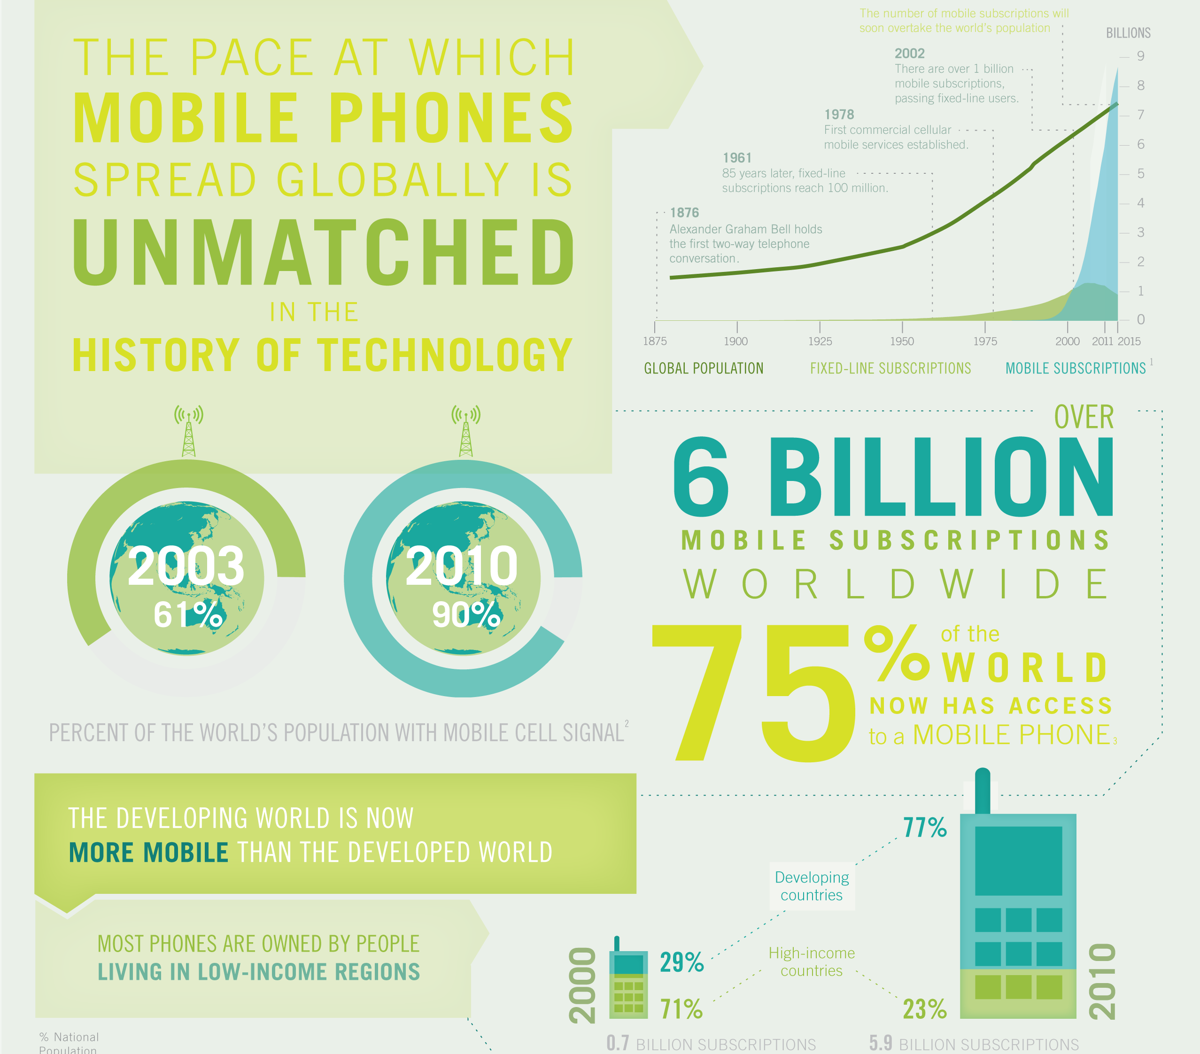

Slide 3
NSW Police Resilience Training Trial
Training Program
4 x 2 hour Workshops at the Police Academy (Adapted from Frank Bond’s Protocol)
Skills practice in between sessions
Objectives
For students to develop psychological flexibility
To prevent psychological injuries in the workplace

Slide 4
The Challenge: Training Transfer
A recruit 6 months onto the job:
“I wasn’t stressed when you ran the program so I didn’t do the homework exercises that you set.
Now I can’t remember much of the program.
And now I am on the job and I am experiencing the pressures of the job I wish I had paid more attention.
It would have been better if I was doing resilience training now.”
Notes:
Key findings of NSW Police Trial
People have different needs
Not relevant for many as they are not on the job yet
They are focused on passing their course

Slide 5
The Need
Universal Prevention programs need to be relevant for participants at different stages of change
It must be easy for participants to apply the skills when they are ready
Preparation > Action
Maybe a smartphone App could help?

Slide 6
Who is doing research in this area?
Maria Karekla
Kien Hoa Ly
Eric Morris
Jonathan Bricker Jacqueline Pistorello Roger Vilardaga
Robyn Walser
Sara Boucher
Joseph Ciarrochi
Chris Horan
Stefano Picozzi
Research Contact List will be available on the ACBS Conference Website (Thanks Sara Boucher)

Slide 7
Student Pilot
Pre-training questionnaire (August)
2 hour stress and resilience training workshop
Highlights of the police project
Private resilience building exercises (Over 1 Month period)
Workbook OR
Smartphone App Application
Reminders to practise psychological flexibility exercises
Psychological Flexibility Resources – Audio, Forms
Post-training questionnaire (September)
Research Questions:
Do students that get the App practise the exercises more than those that get paper instructions?
Do practise levels have beneficial effects on outcome measures.

Slide 8
Symposium Objective
To showcase research currently being conducted applying APP using mobile and web technologies

Slide 9
Symposium Presentations
Presentation 1 (20 min + 5 min questions)
How mobile text-messages and the Internet can be of service in delivering an ACT-intervention for achieving smoking cessation.
Vasilis Vasiliou, University of Cyprus
Stella Nicoleta Savvides, Ph.D. Candidate, University of Cyprus
Maria Karekla, Ph.D., University of Cyprus
Presentation 2 (20 min + 5 min questions)
Mobile technology fostering ACT-practice in daily life
Tim Batink, Ph.D. Candidate, Maastricht University
Dina Collip, Ph.D., Maastricht University
Marieke Wichers, Ph.D., Maastricht University
Presentation 3 (20 min + 5 min questions)
Developing an ACT smartphone intervention with potential high impact
Jonathan Bricker, Ph.D., Fred Hutchinson Cancer Research Center & University of Washington
Julie A. Kientz, Ph.D., University of Washington
Katrina Akioka, B.S., Fred Hutchinson Cancer Research Center
Discussant (10 min)
Joseph Ciarrochi, Ph.D., University of Western Sydney

Slide 10
ACTing with Technology - PANEL
Friday, 430pm,
Mathews Theatre C
PANEL MEMBERS
Joseph Ciarrochi (Sydney)
Ph.D., University of Western Sydney
Robyn Walser (San Francisco)
Ph.D., National Center for PTSD & TL Consultation Services
Tim Batink
Ph.D. student, Maastricht University
Neli Martin (Brisbane)
Private Practice
Stefano Picozzi (Sydney)
Ph.D. student, Australian National University
Jacqueline Pistorello (Reno)
Ph.D., University of Nevada, Reno Counseling Services
Louise Hayes (Melbourne)
Ph.D., Orygen Youth Health & Private Practice
Send questions to chrisjhoran@gmail.com

